Slide 1
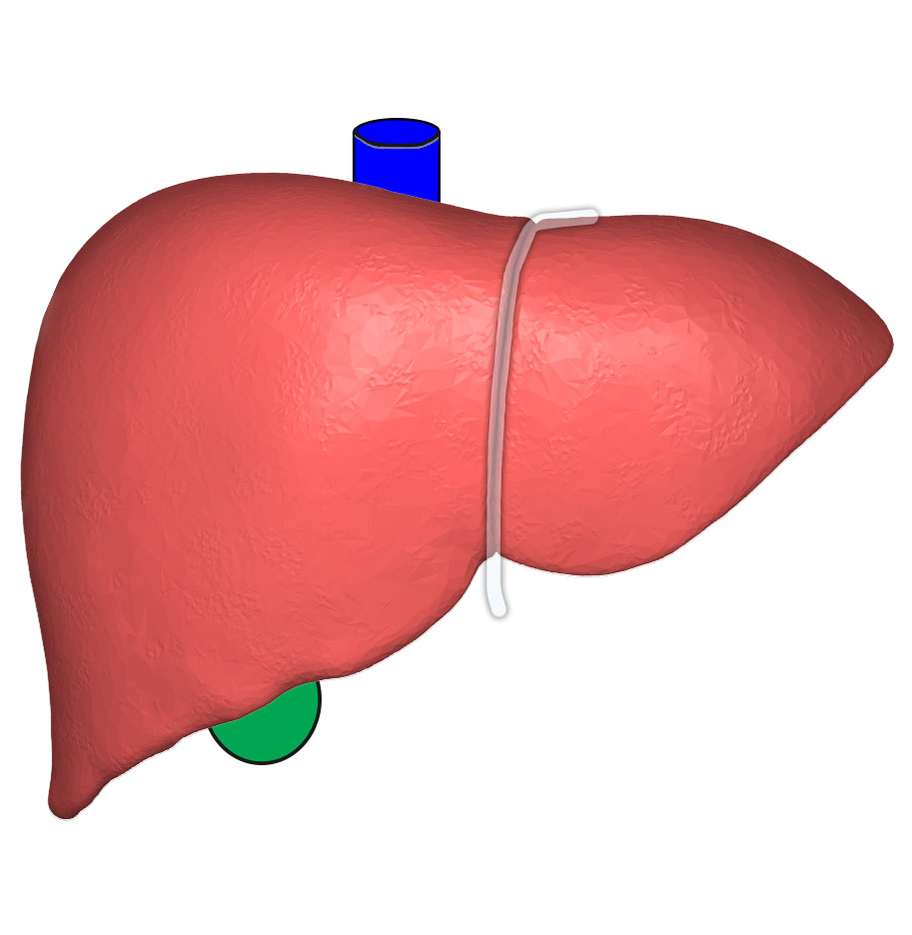

Liver Cirrhosis Prediction System
Sir CR Reddy College Of Engineering
Department of Computer Science and Engineering

Slide 2
Our Team
Under the Guidance of:
P. Chaitanya, M.Tech
Assistant Professor, CSE
Team Members
P. Jathin (20B81A05D0)
P. Sai Harish (20B81A05D1)
P. Anjaneyulu (20B81A05D3)
P.G.D.L. Tejaswini (20B81A05D4)
P. Gopi Kiran (20B81A05D5)

Slide 3
Agenda
Abstract
Problem Statement
Existing Solution
Proposed System
System Architecture
Algorithms
Implementation
Results

Slide 4
Abstract
This research addresses the growing concern of liver cirrhosis in North America, predominantly linked to alcohol consumption.
Leveraging advanced machine learning techniques, we aim to develop a comprehensive predictive model by integrating lifestyle factors (such as alcohol consumption, dietary habits, and exercise) and health indicators (including viral hepatitis status and liver function tests).
The model seeks to accurately assess an individual's risk of developing liver cirrhosis, facilitating early diagnosis and targeted interventions.
The outcomes of this study hold the potential to significantly impact public health by providing healthcare professionals with an effective tool for proactive cirrhosis risk assessment, ultimately leading to improved patient outcomes and informed preventive measures

Slide 5
Problem Statement
Liver cirrhosis is a big problem globally, especially in North America, where more people are getting it, mostly because of drinking alcohol. Even though doctors know more about it now, we still need better ways to find it early and figure out who's at risk.

Slide 6
Existing Solution
In the realm of liver cirrhosis prediction, the existing systems typically rely on traditional statistical methods, clinical scoring systems, and individual biomarkers.
While these approaches have been valuable in clinical practice, they often lack the predictive power and accuracy required for early detection and intervention.
Disadvantages
Accuracy: The accuracy is one of the major entity which can effect the entire outcome of the project
Time: Due to the usage of old machine learning algorithm, the time consumption is higher than the new algorithm

Slide 7
Proposed System
Usage of latest algorithms line XGBoost (Extreme Gradient Boosting Algorithm) and EDA ( Exploratory Data Analysis ) may help to increase the accuracy and reduce the time consumption
The problem statement for predicting liver cirrhosis using XGBoost and Exploratory Data Analysis (EDA) typically involves developing a machine learning model that can accurately identify individuals at risk of liver cirrhosis based on various clinical and demographic features. The goal is to assist in early detection, diagnosis, and reduction of risks and mortality associated with liver disease.

Slide 8
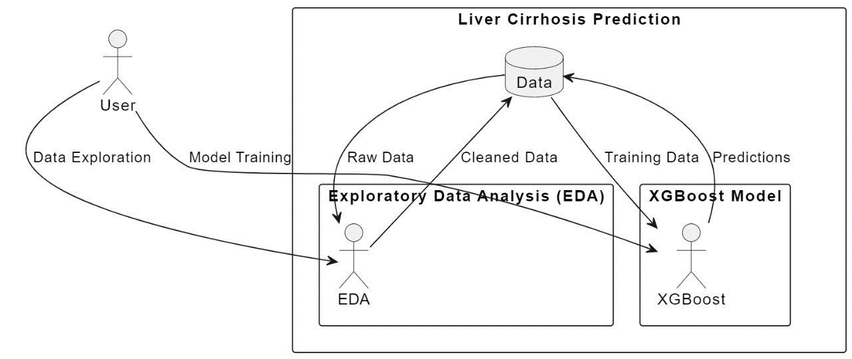
System Architecture

Slide 9
Algorithms

Slide 10
EDA and XGBoost
Exploratory Data Analysis (EDA) refers to the method of studying and exploring record sets to apprehend their predominant traits, discover patterns, locate outliers, and identify relationships between variables. EDA is normally carried out as preliminary step before undertaking extra formal statistical analyses or modeling
XGBoost may be formally defined as a decision tree-based ensemble learning framework that uses Gradient Descent as the underlying objective function and comes with a lot of flexibility while delivering the desired results by optimally using computational power

Slide 11
Stratified K-Fold
The StratifiedKFold class from sklearn.model_selection is used for cross-validation. Cross-validation is a technique for assessing how well a model will generalize to an independent dataset.
Cross-validation, in general, is a technique used to evaluate the performance of a machine learning model. Instead of splitting the data into a training set and a separate validation set, cross-validation involves splitting the data into multiple folds or subsets. The model is then trained on a portion of the data (training set) and evaluated on the remaining portion (validation set). This process is repeated multiple times, with each fold serving as the validation set exactly once.

Slide 12
Modules

Slide 13
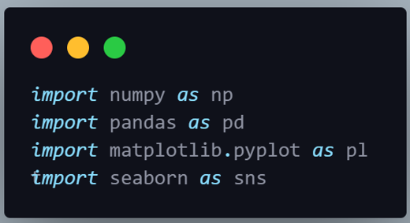
Installing and Importing Required Libraries
Numpy: It is a fundamental package for scientific computing with Python. It provides support for arrays, matrices, and mathematical functions to operate on these arrays.
Pandas: It is a powerful data manipulation and analysis library. It provides data structures like DataFrame and Series, which are very useful for working with structured data.
Matplotlib: It is a comprehensive library for creating static, animated, and interactive visualizations in Python. It provides a MATLAB-like interface for plotting.
Seaborn: It is a statistical data visualization library based on Matplotlib. It provides a high-level interface for drawing attractive and informative statistical graphics.

Slide 14
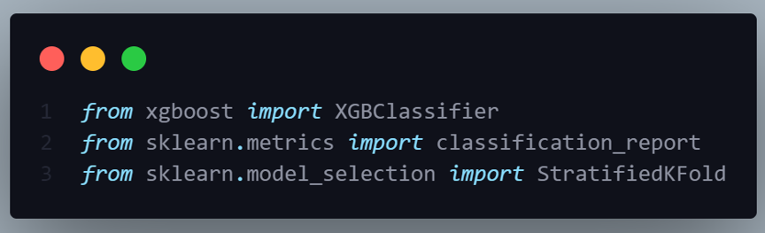
Installing and importing required libraries
XGBoost (from xgboost import XGBClassifier): XGBoost is an open-source software library that provides an efficient and scalable implementation of gradient boosting algorithms. It's widely used for supervised learning tasks, particularly in structured/tabular data problems.
Scikit-learn Metrics (from sklearn.metrics import classification_report): Scikit-learn is a popular machine learning library in Python that provides simple and efficient tools for data mining and data analysis.
Scikit-learn Model Selection (from sklearn.model_selection import StratifiedKFold): The StratifiedKFold class from sklearn.model_selection is used for cross-validation. Cross-validation is a technique for assessing how well a model will generalize to an independent dataset.

Slide 15

Framework Used in GUI
Tkinter
a Python library that provides tools and widgets for building graphical user interface (GUI) applications. It's the standard Python interface to the Tk GUI toolkit, and is included with standard Linux, Microsoft Windows, and macOS installs of Python.

Slide 16
Implementation

Slide 17
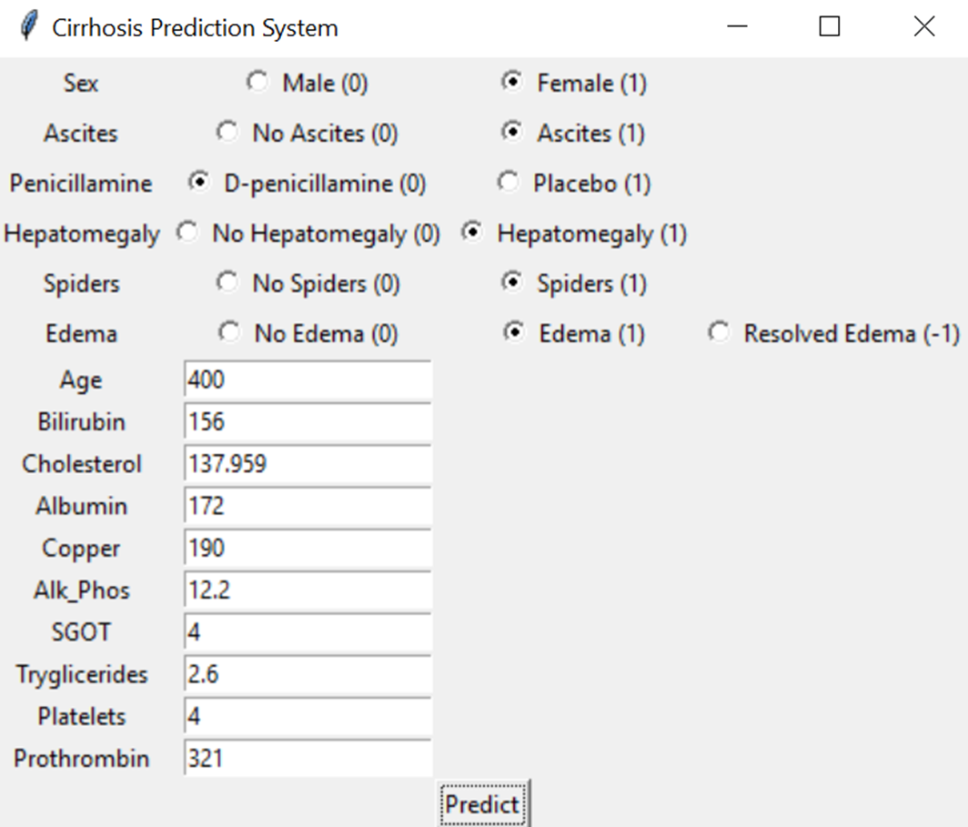

Slide 18
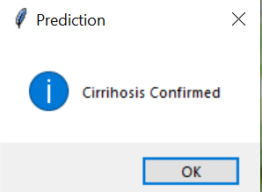
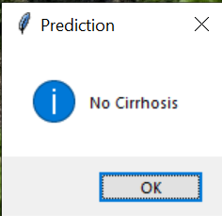

Slide 19
Results
Previous Model:
• Algorithm: Logistic Regression
• Accuracy: 70%
Improved Model:
• Algorithm: XGBoost with Exploratory Data Analysis (EDA)
• Accuracy: 76%

Slide 20
Thank you

